Slide 1
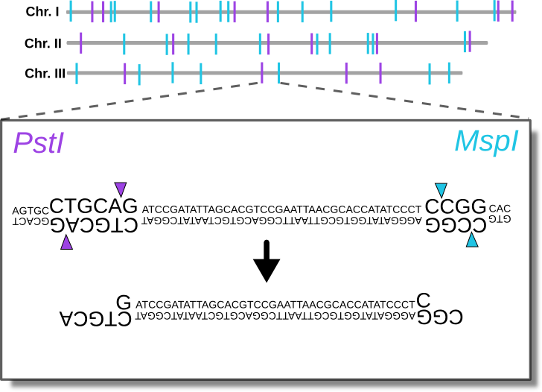
Lab 12: Introduction to RADseq data
BIOL4174/5174 Conservation Genetics Spring 2018
Tyler Chafin

Slide 2
Next-generation sequencing
Millions of sequences at $0.05 per million bases
Can sequence entire genomes
Whole-genome sequencing often too expensive for population-level (hundreds, thousands of individuals)

Slide 3
Reduced-representation sequencing
To be useful at the population-level, need to reduce the genome consistently across individuals
Most common methods:
Restriction-site Associated DNA sequencing (RADseq)
Targeted enrichment methods

Slide 4
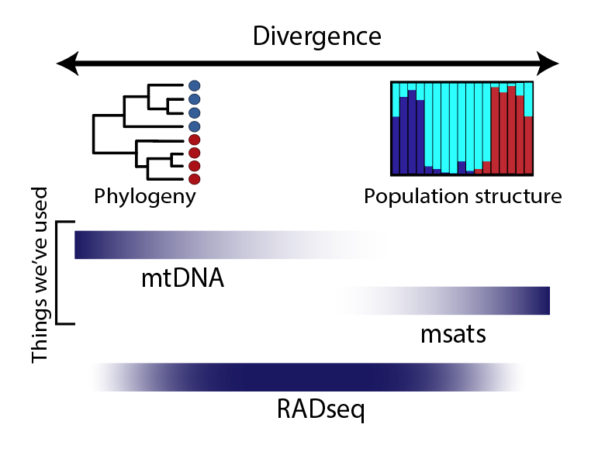

Slide 5
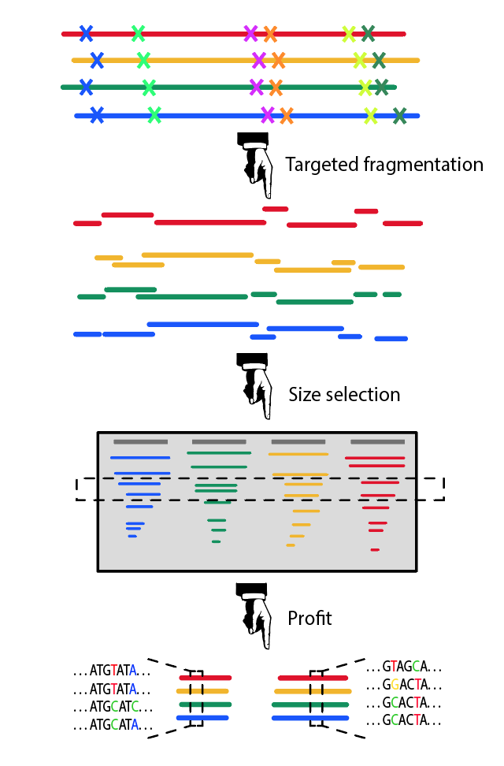
RAD-seq

Slide 6
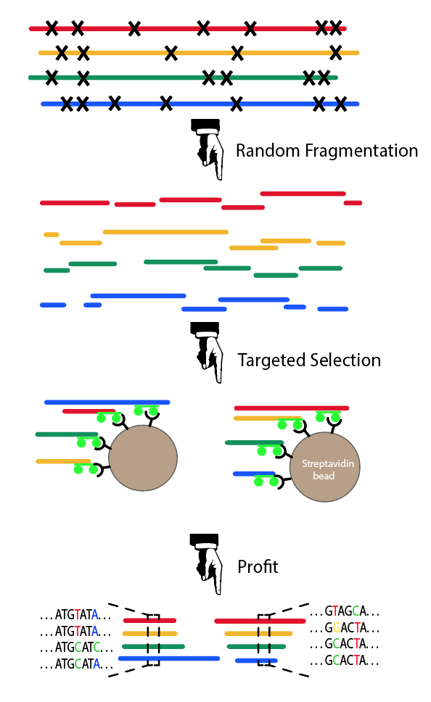
RAD-seq
Targeted Enrichment

Slide 7
1. Digest genomic DNA with paired restriction enzymes
Double-digest RADseq

Slide 8


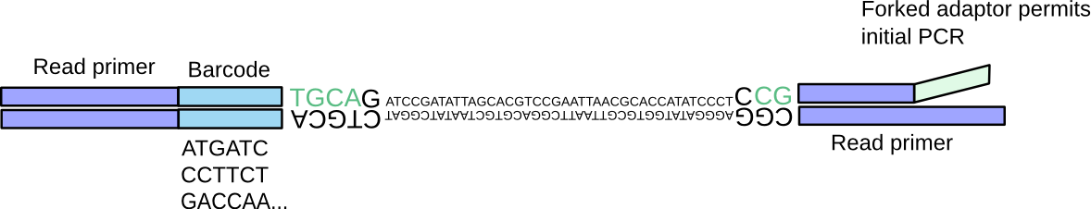
2. Ligation of barcoded adaptors
Double-digest RADseq
Barcoded samples can then be pooled

Slide 9
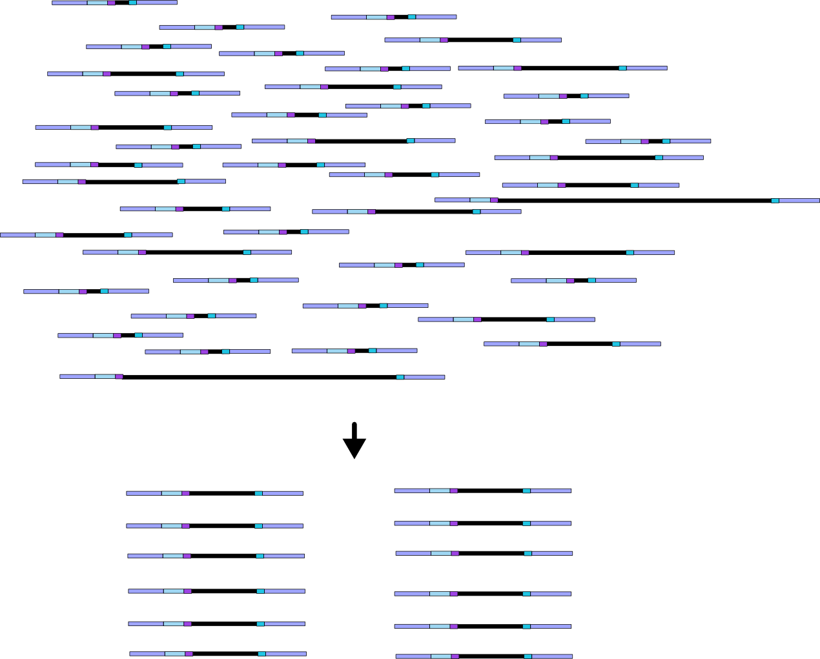
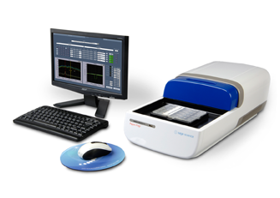
3. Size selection of digested fragments
Double-digest RADseq

Slide 10
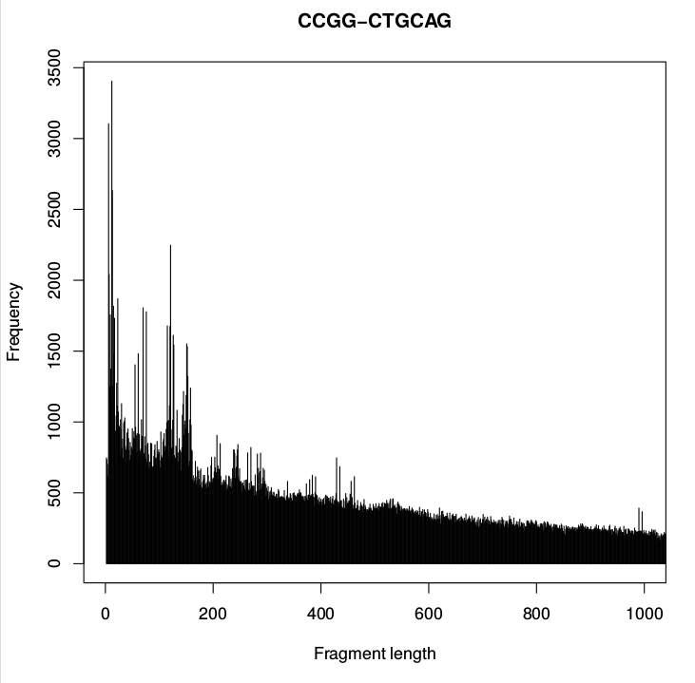
3. Size selection of digested fragments
Double-digest RADseq
Size range manipulated to target specific # of loci

Slide 11
3. Size selection of digested fragments
Double-digest RADseq
Size range manipulated to target specific # of loci

Slide 12
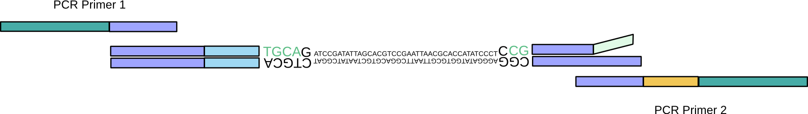
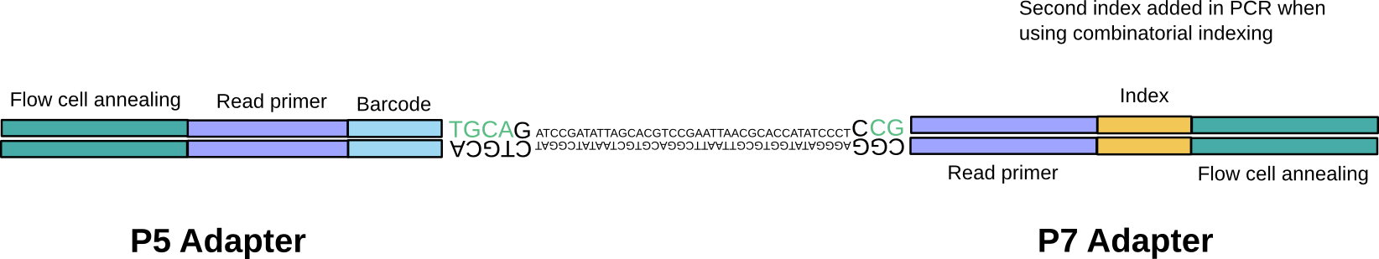
4. Adaptor extension by PCR
Double-digest RADseq

Slide 13
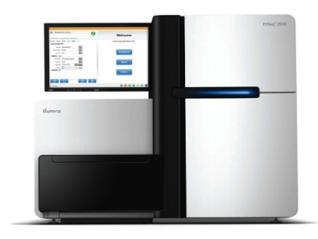
Final library
Double-digest RADseq
P5-P5 and P7-P7 fragments fail bridge amplification and are not sequenced

Slide 14
Illumina Sequencing
https://www.youtube.com/watch?time_continue=1&v=fCd6B5HRaZ8

Slide 15
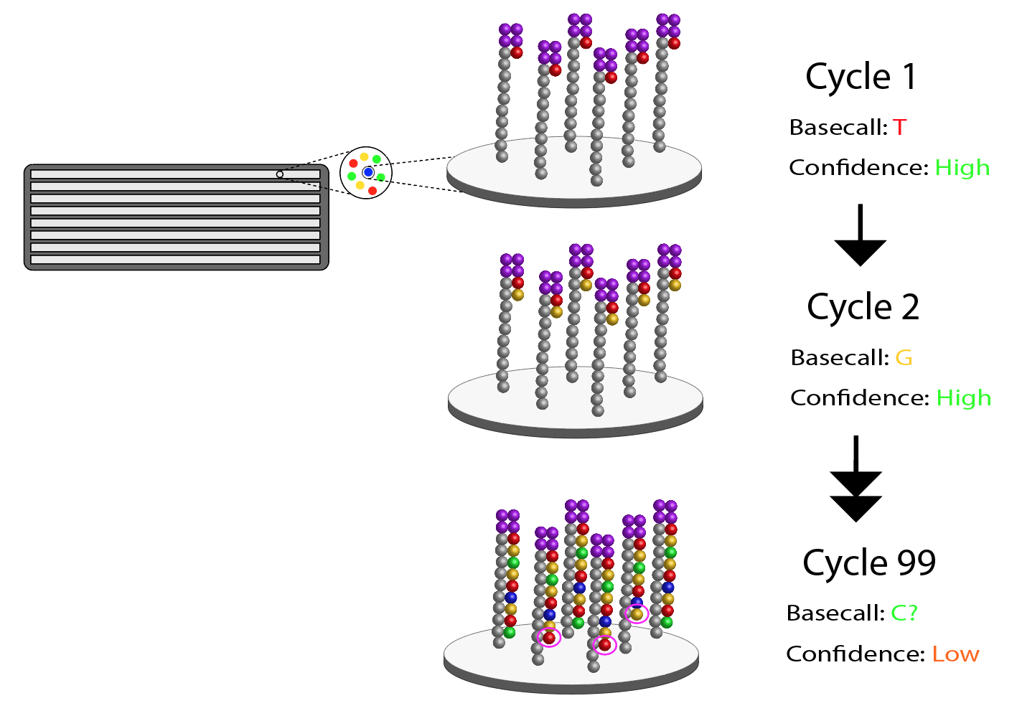
Error increases with cycle number

Slide 16
Error increases with cycle number

Slide 17
Error increases with cycle number

Slide 18
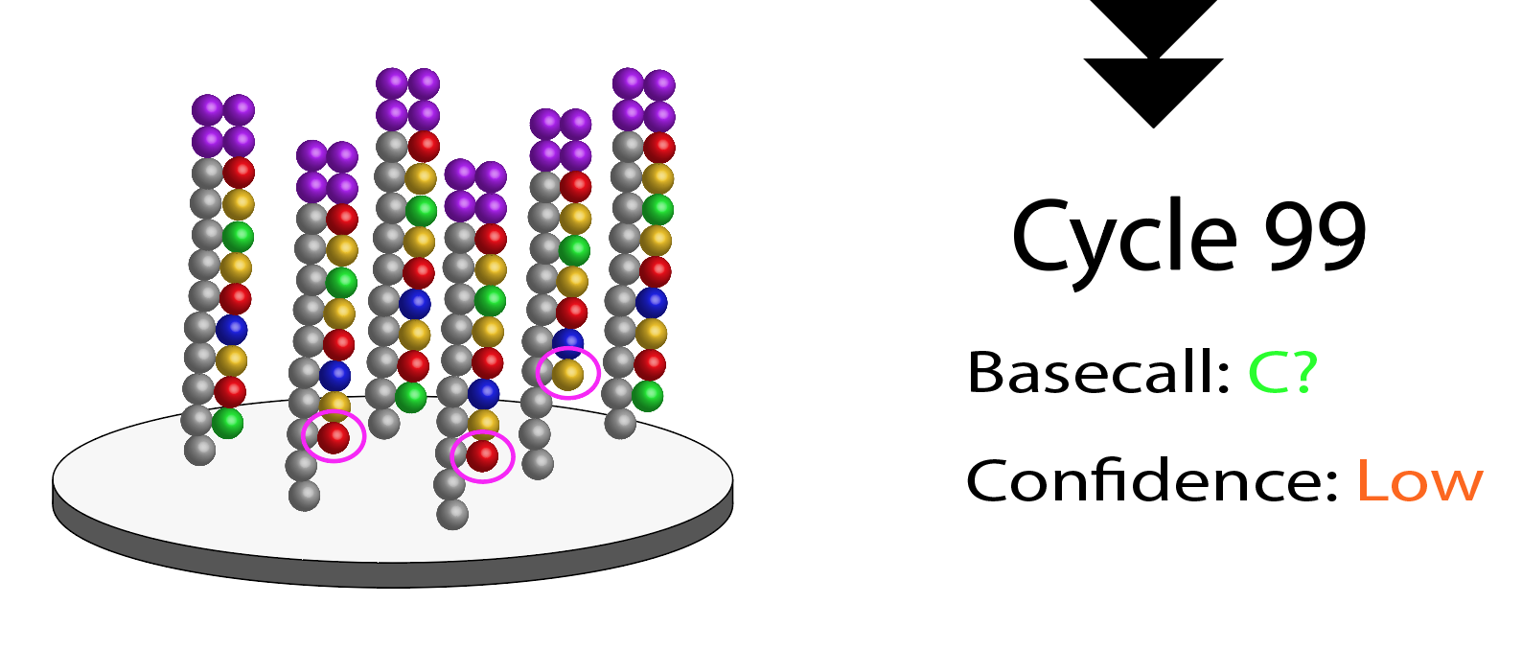
Error increases with cycle number

Slide 19
Error increases with cycle number
“Quality Score” (Confidence)
Position in read (base #)

Slide 20
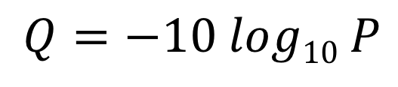
Reporting confidence: Phred scores
Phred quality scores- used in FastQ to describe confidence
Where P = probability of an incorrect base call
1 in 10 chance of incorrect base call (P = .1) will yield a quality score of 10.
1 in 100 chance of incorrect base call (P = .01) will yield a quality score of 20
$$Q=−10 log10 P$$

Slide 21
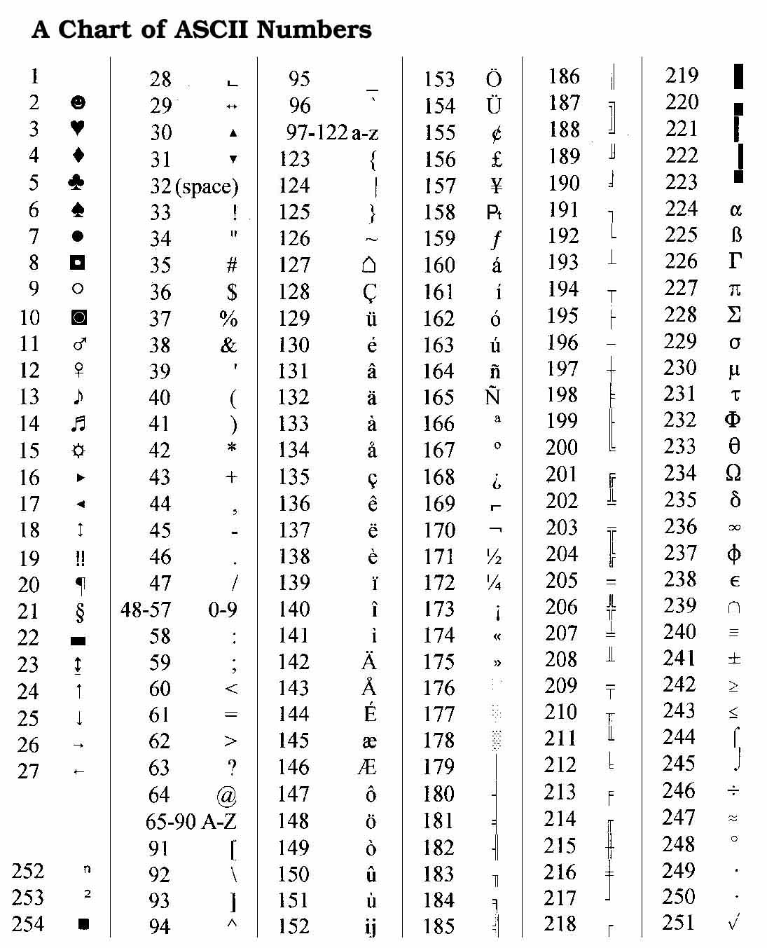
Reporting confidence: Phred scores
Phred quality scores, represented using ASCII characters
This is done to save space!
“31” is 2 characters (=2 bytes), whereas “@” is 1 byte

Slide 22
Reporting confidence: FastQ Format
One of these 4-line blocks for each read!

Slide 23
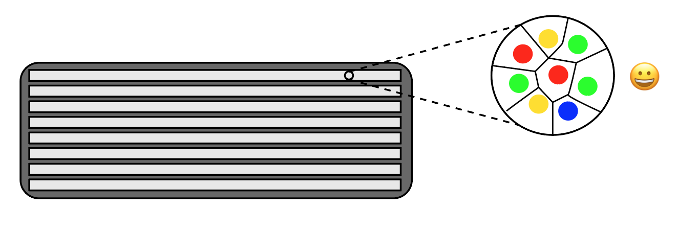
Illumina cluster delimitation
Illumina uses an algorithm to look at patterns of fluorescence in the first ~11 bases to ‘find’ clusters (representing copies of the same template fragment)

Slide 24
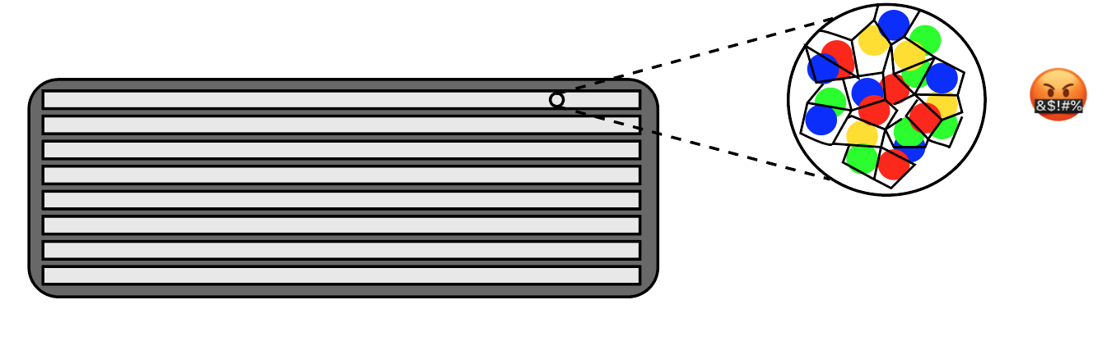
Illumina cluster delimitation
If the flowcell is loaded with too much library, clusters can overlap, confusing the algorithm. This results in many low-confidence base-calls.

Slide 25
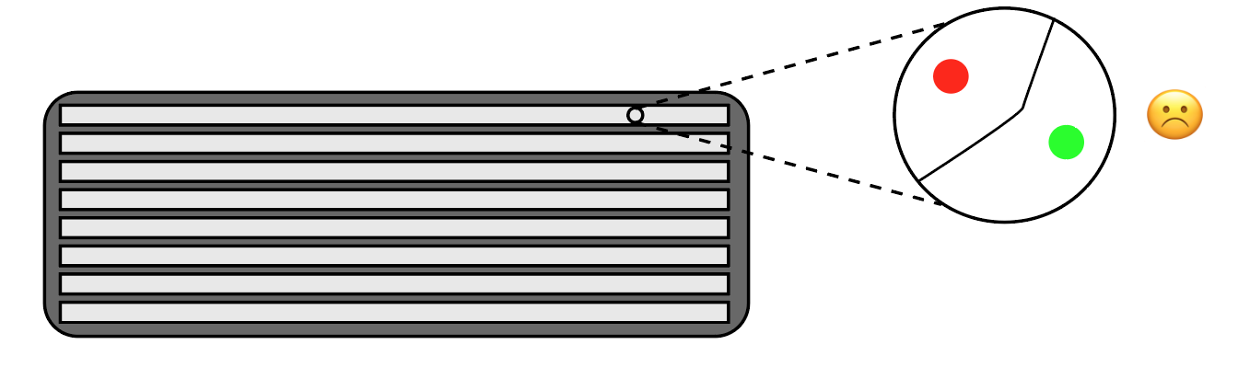
Illumina cluster delimitation
Loading too little library leads to inefficient use of ‘flowcell space’, which means less data (and wasted $$)

Slide 26
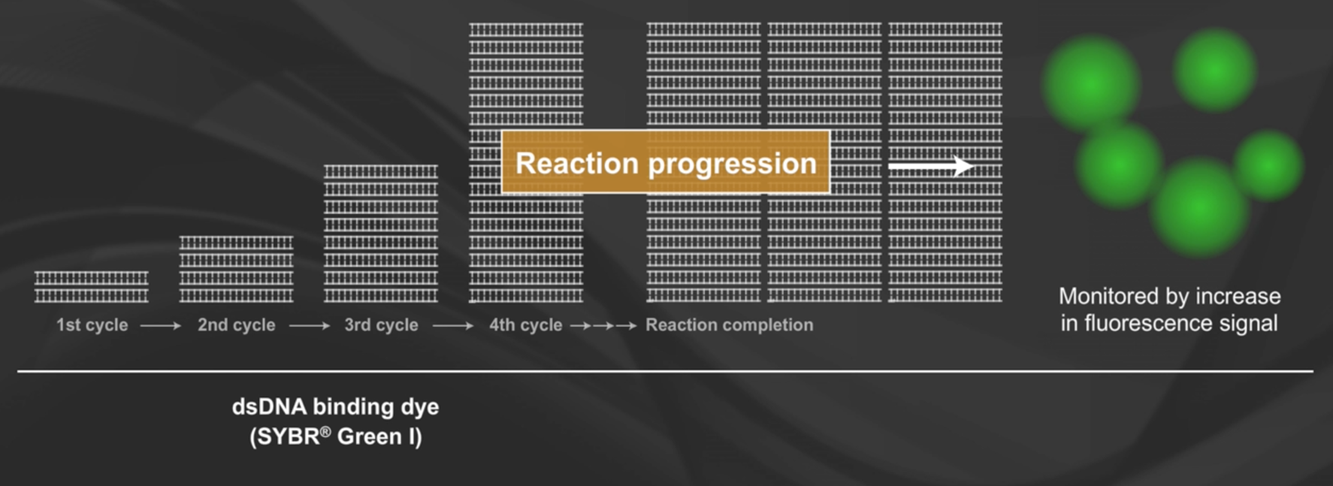
Illumina cluster delimitation
Optimal cluster density requires QC before loading. Generally, the facility will use quantitative PCR (qPCR) to estimate proportion of DNA which is sequence-able

Slide 27
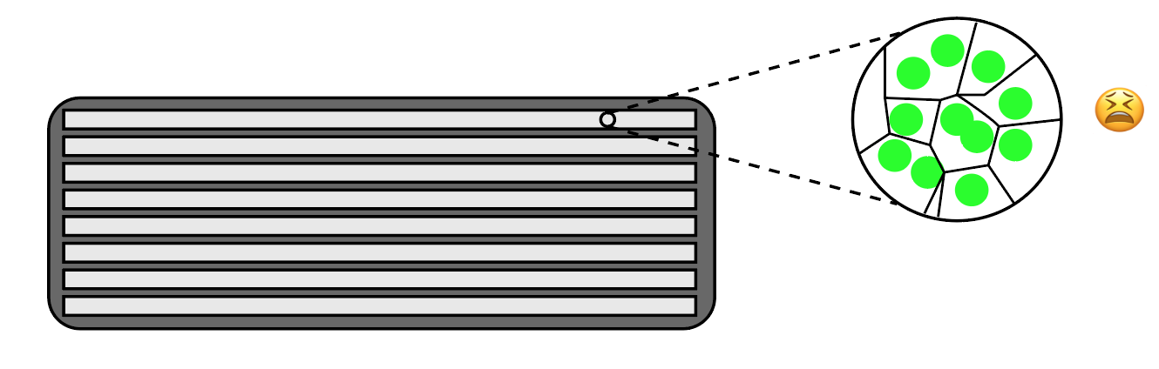
Illumina cluster delimitation
When the library is low-diversity, the algorithm can also have a hard time delimiting clusters. The solution is to add (or ‘spike-in’) high diversity DNA like PhiX viral DNA, which then has to be removed bioinformatically

Slide 28
Examining per-tile quality in FastQC
RED = BAD
Position in flowcell lane
Position in read (base #)

Slide 29
Assembling RADseq data
Most common options:
pyRAD/ipyRAD: The one I use
STACKS: Very usable and fast, but I prefer pyRAD
dDocent: I don’t have any experience with this one. A lot of dependencies, but manages install with bioconda now!
aftrRAD: Written in Perl and R
DIY: Write your own pipeline. Still a fairly common option

Slide 30
pyRAD / ipyRAD
pyRAD: Eaton (2014) Bioinformatics
No longer being supported
ipyRAD: Successor to pyRAD, currently in development
Faster – Better parallelization with MPI
More flexible – Allows ‘forking’ to better re-start pipeline with different options
More extensible – Several built-in analysis tools (e.g. ABBA/BABA tests, tetrad SVDQuartets-like method)

Slide 31
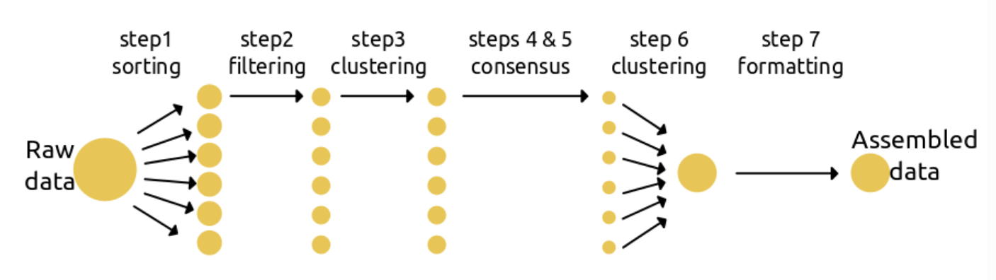
pyRAD / ipyRAD

Slide 32

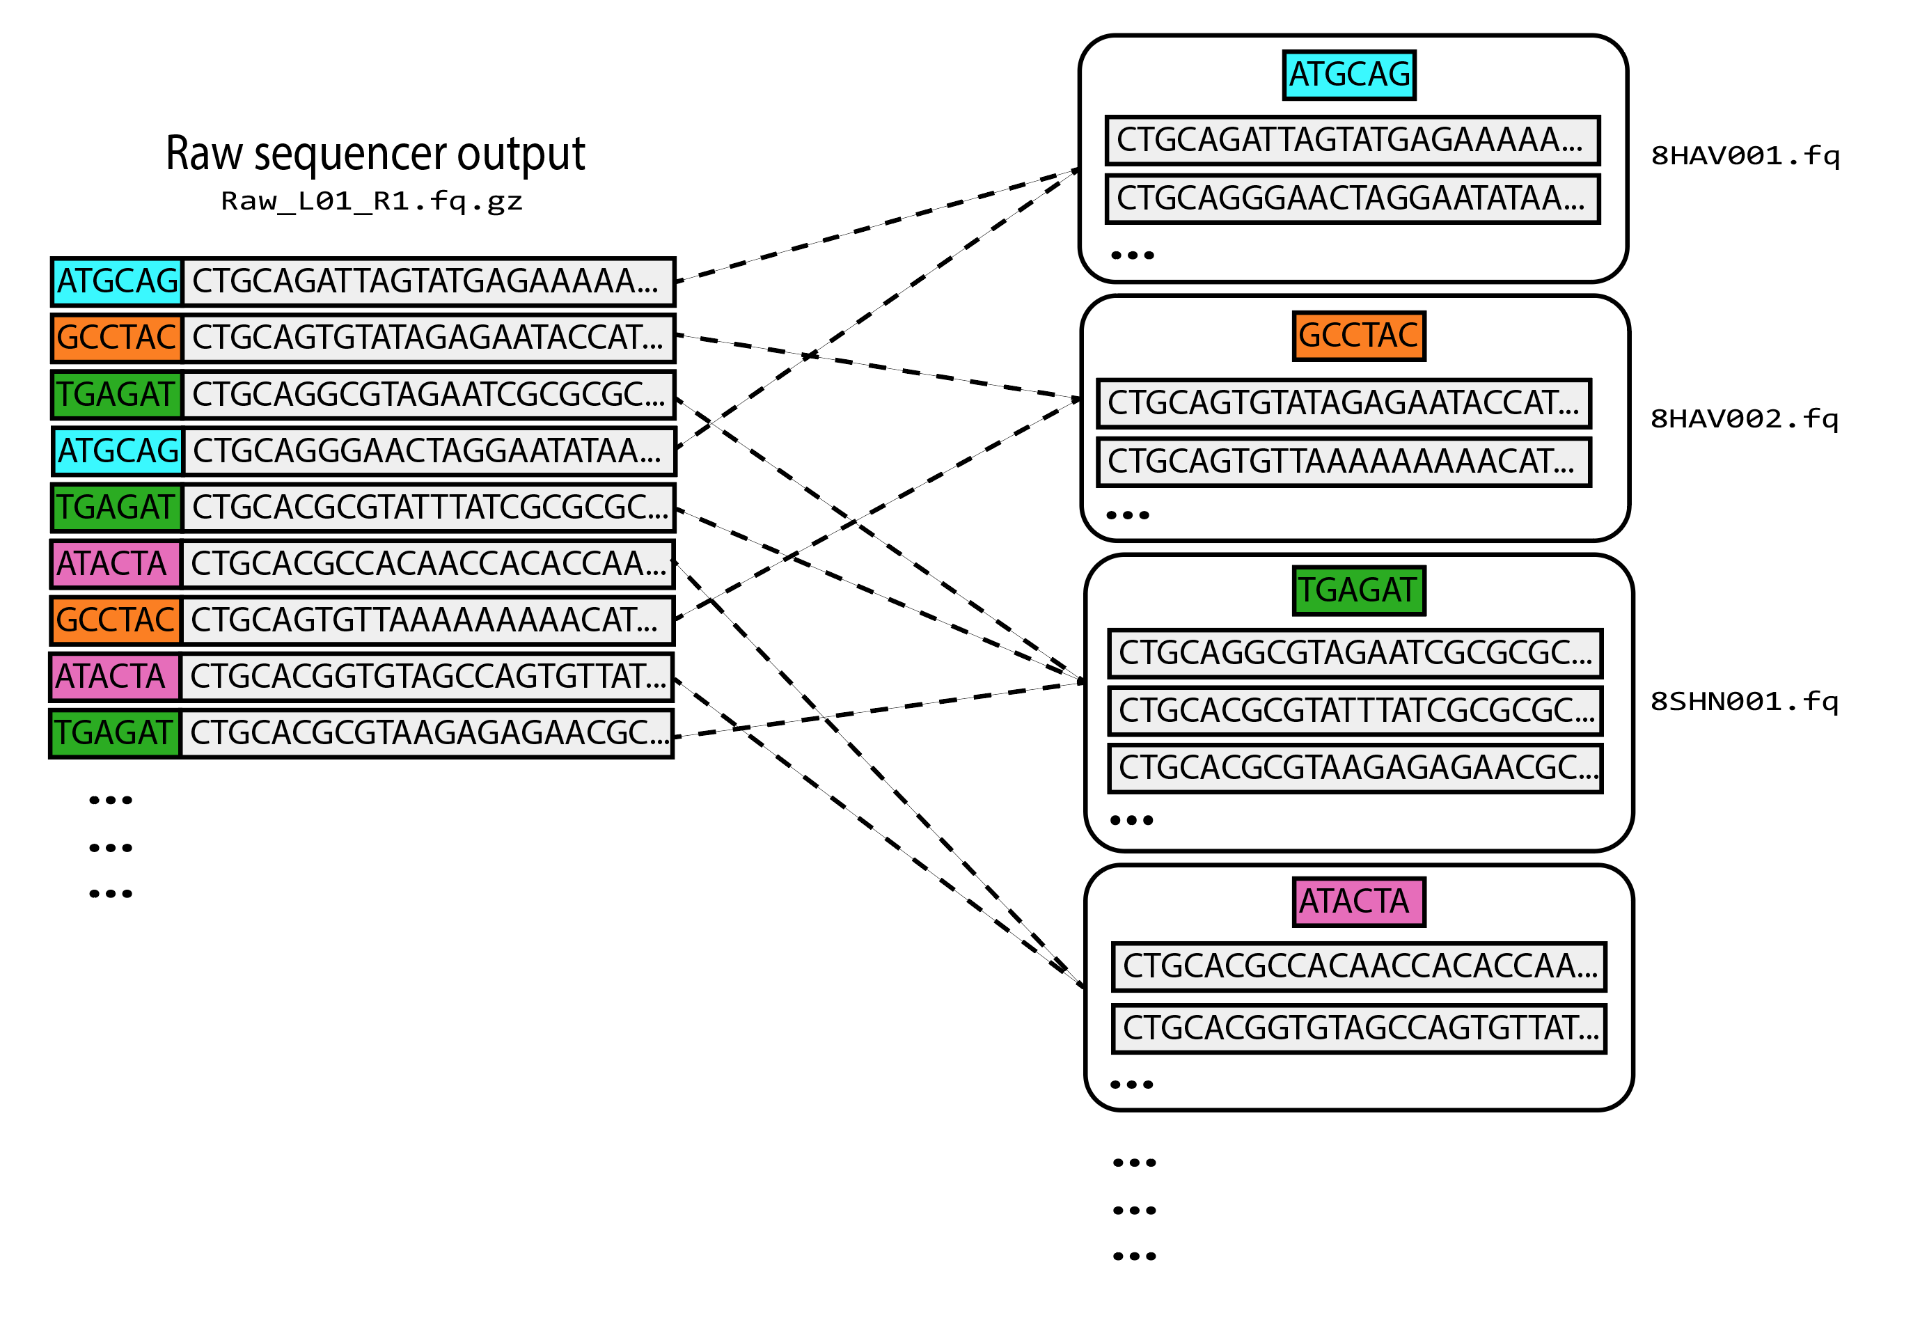
pyRAD/ipyRAD
Step 1: Demultiplexing
Reads are sorted per individual using the unique barcode identifier added during library prep

Slide 33
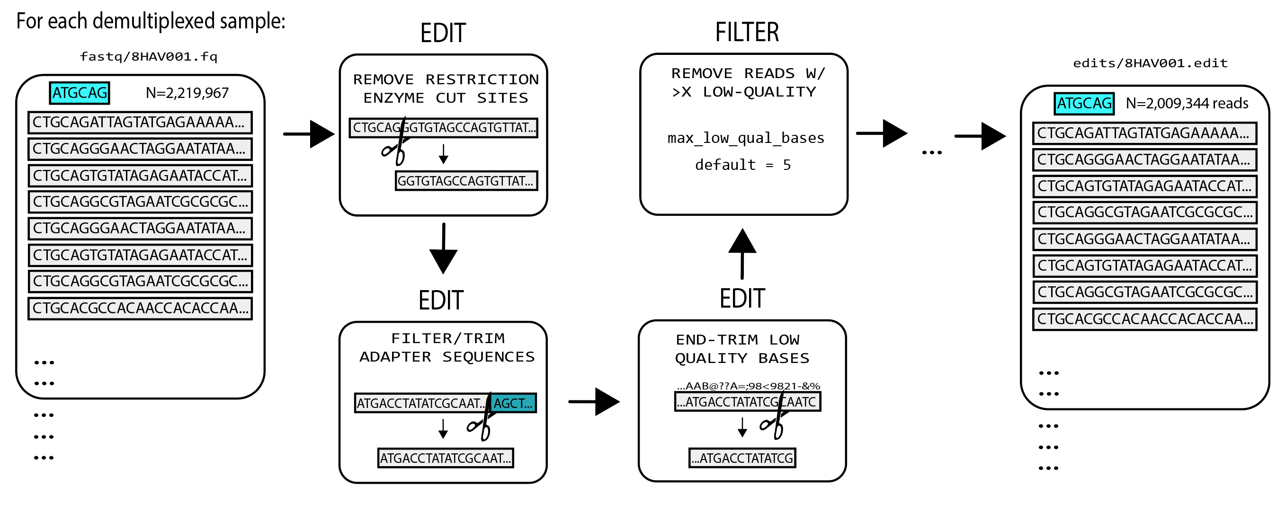
pyRAD/ipyRAD
Step 2: Filtering / Editing reads
Reads for each demultiplexed individual can be edited and filtered using many built-in options

Slide 34
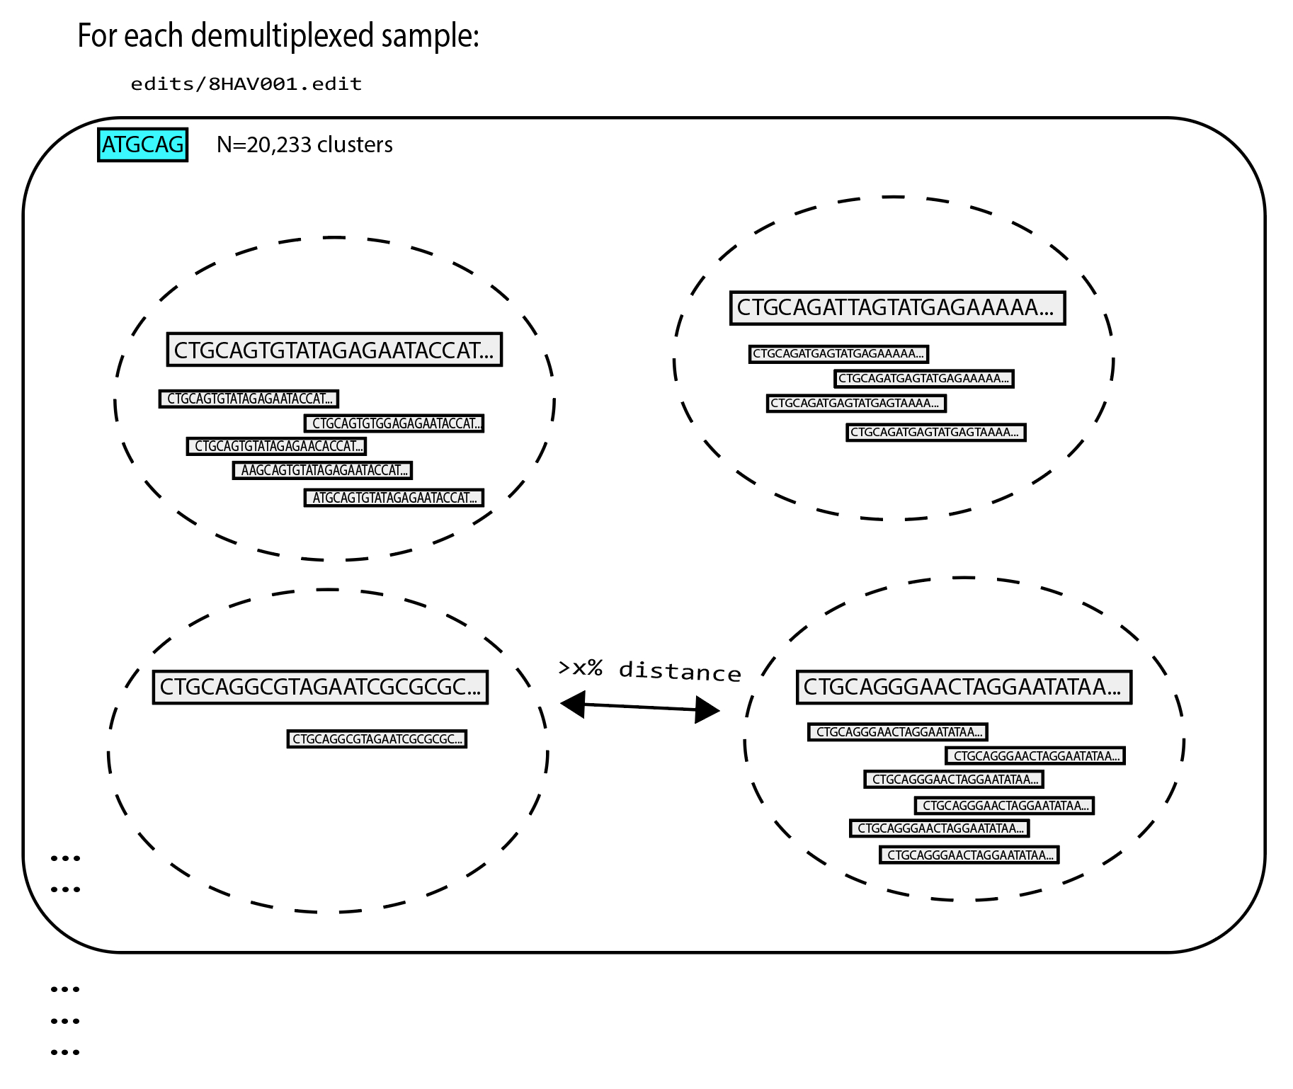
pyRAD/ipyRAD
Step 3: Within-sample clustering
Reads for each demultiplexed individual are then clustered to create putative loci
This is done using a user-defined similarity-threshold (usually 80-95%)

Slide 35
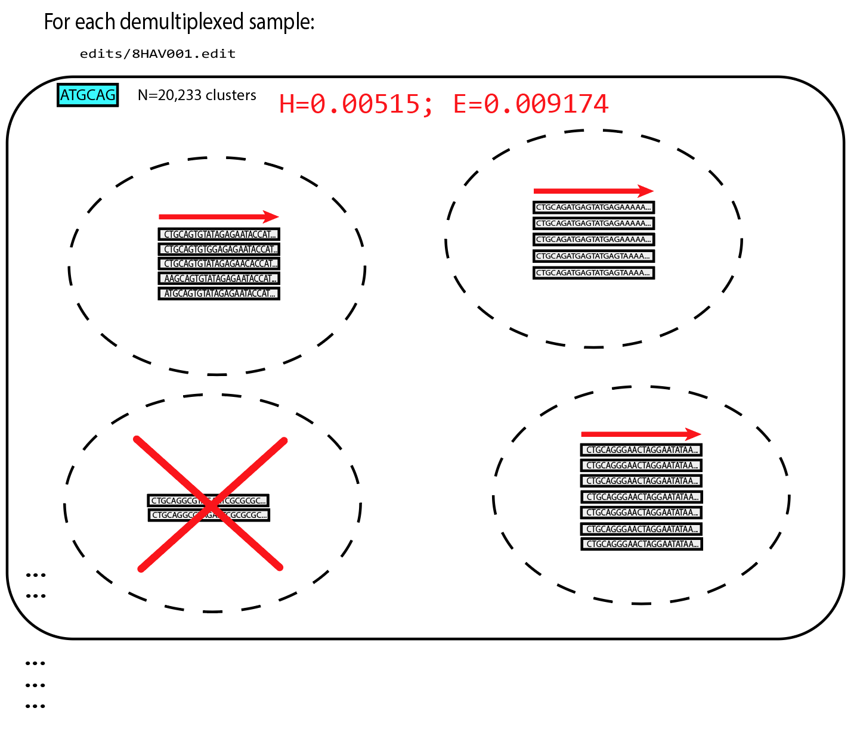
pyRAD/ipyRAD
Step 4: Heterozygosity/Error Estimation
pyRAD then looks across all sites in ‘loci’ with passing read-depth, to estimate global heterozygosity and error rates for each sample
These will be used for base-calling in step 5

Slide 36
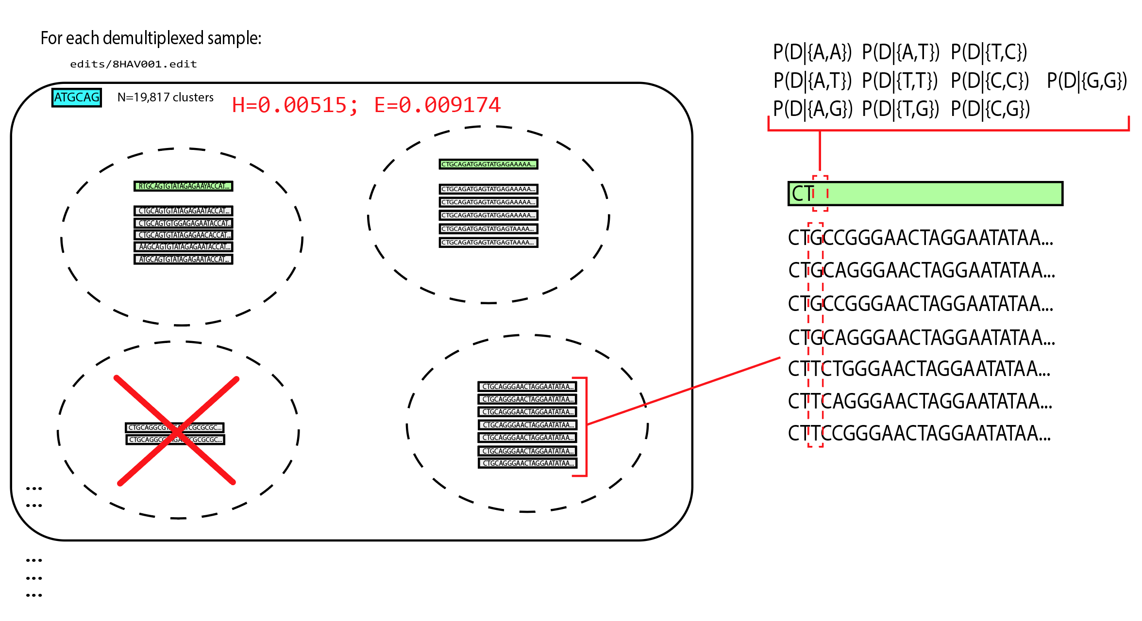
pyRAD/ipyRAD
Step 5: Consensus calling
Using the heterozygosity and error estimates, pyRAD calls a consensus sequence at each base, for every locus

Slide 37
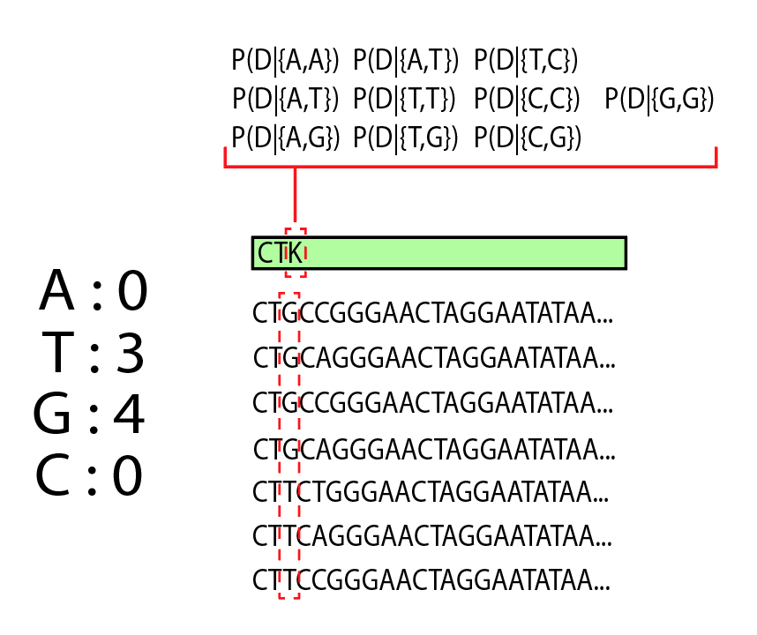
pyRAD/ipyRAD
Step 5: Consensus calling
The general expectation is that, if a site is heterozygous, the coverage (or # of observations) of each base should be ~equal

Slide 38
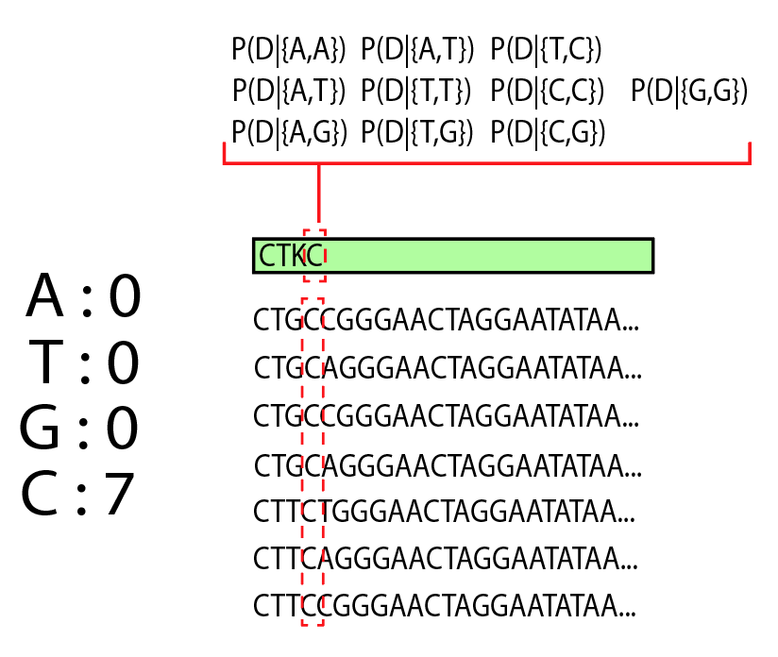
pyRAD/ipyRAD
Step 5: Consensus calling
Homozygous sites should be 100% coverage…

Slide 39
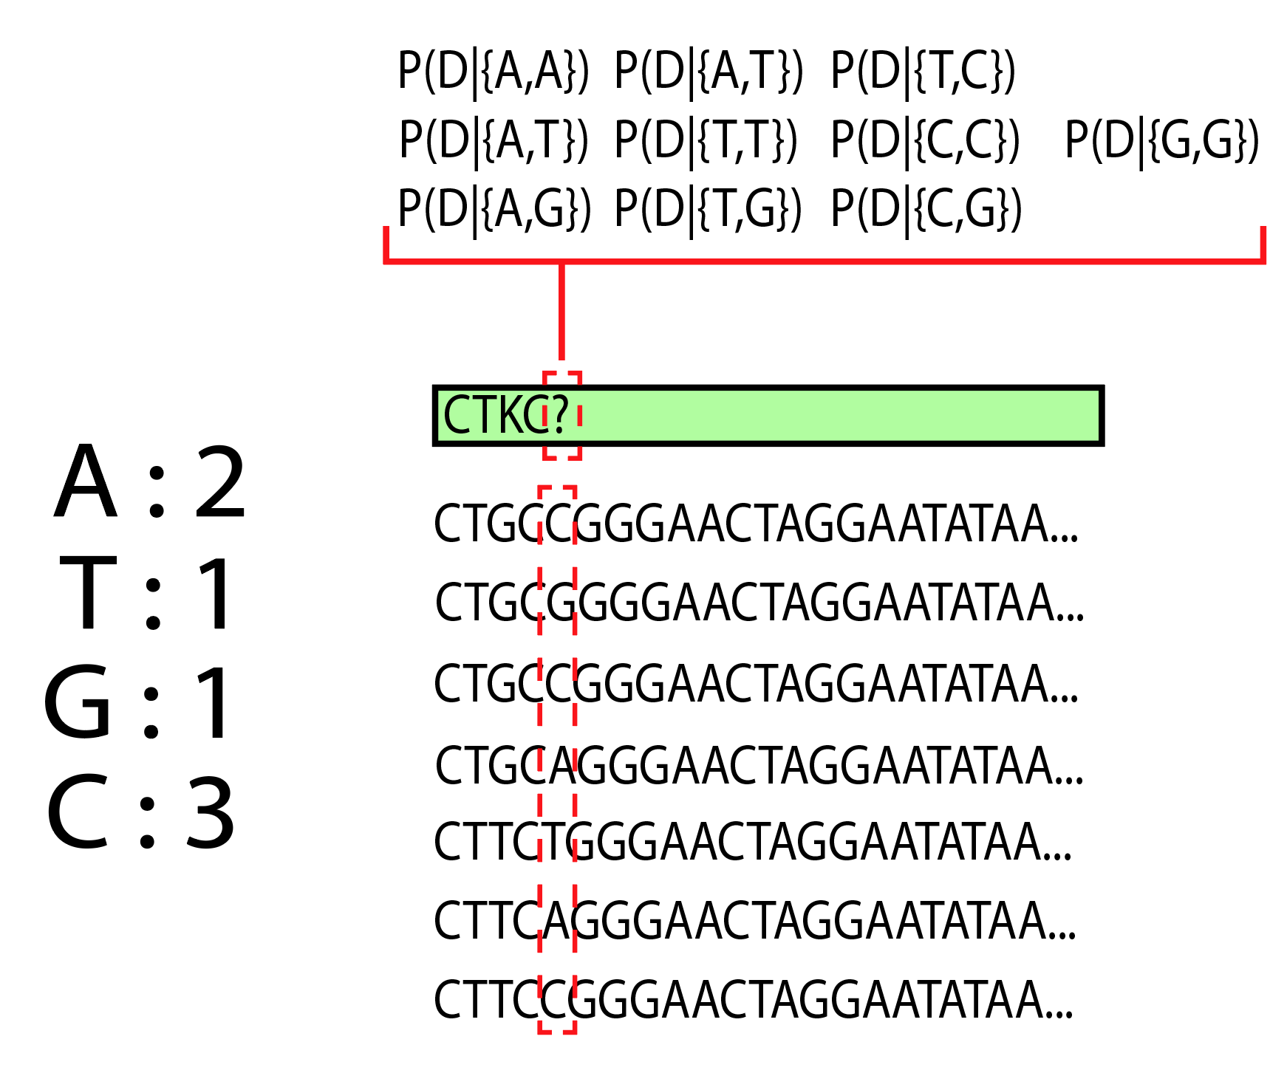
pyRAD/ipyRAD
Step 5: Consensus calling
…But error introduced in PCR and during sequencing can make this difficult.
The higher the depth of sequencing coverage, the lower the uncertainty in base-calling

Slide 40
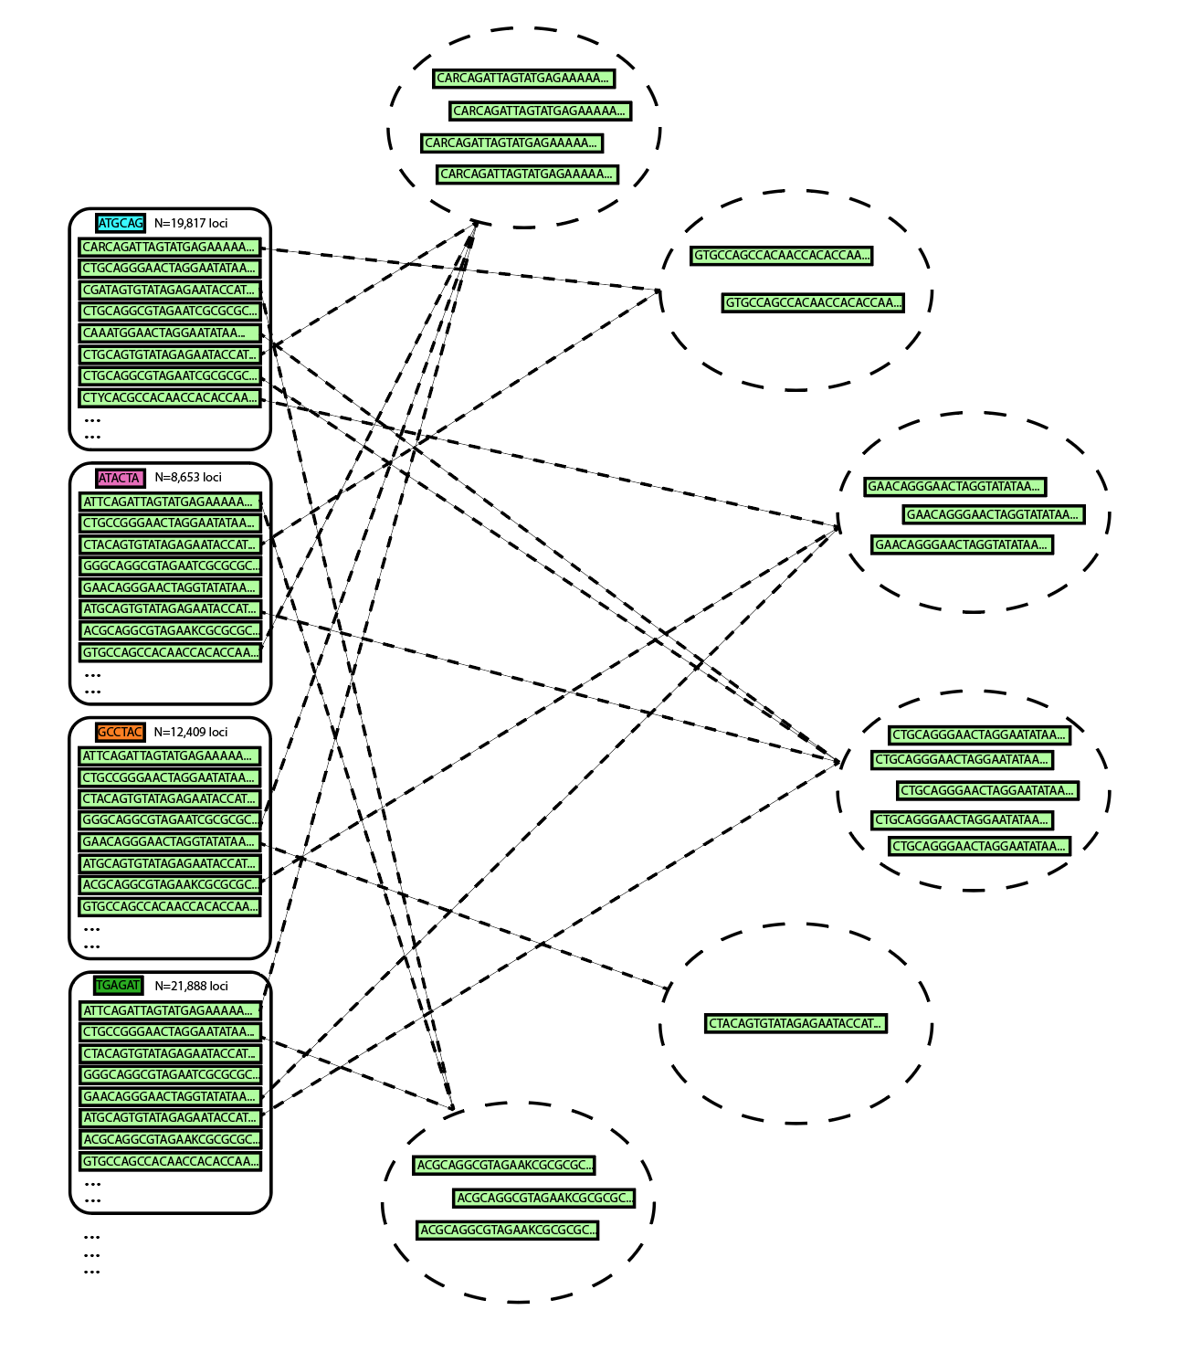
pyRAD/ipyRAD
Step 6: Among-sample clustering
Clusters (read stacks) are then clustered among individuals, to generate a catalog of candidate homologous loci
The same similarity threshold is used from step 3

Slide 41
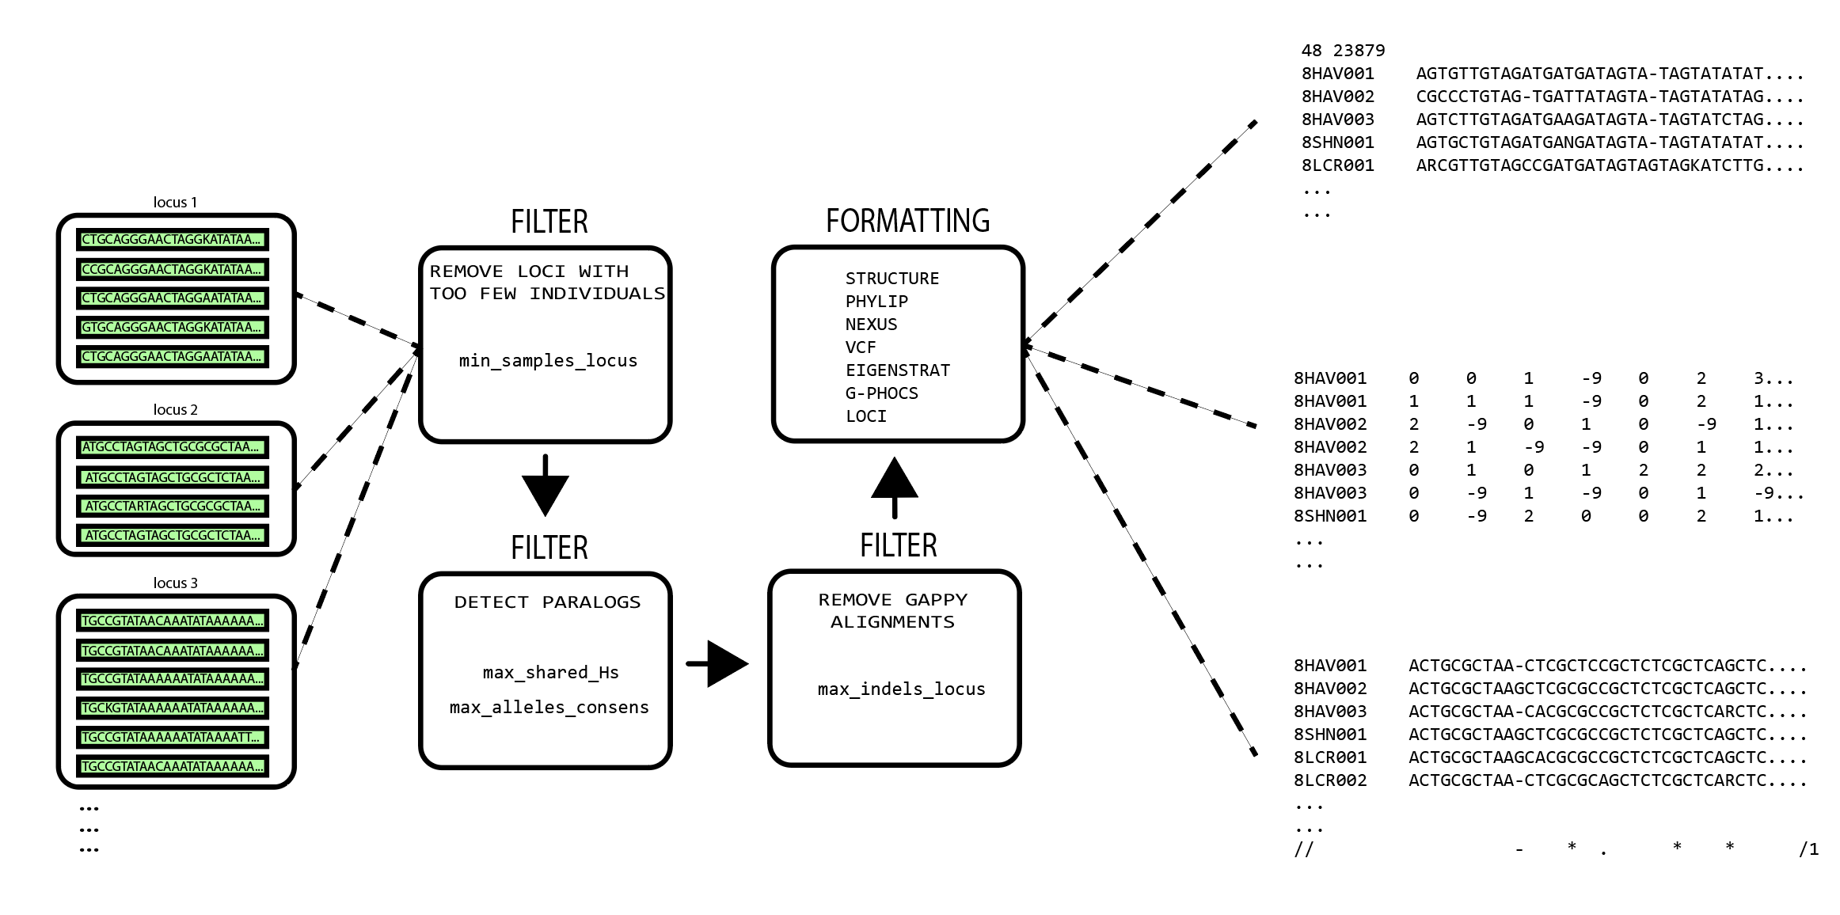
pyRAD/ipyRAD
Step 7: Formatting

Slide 42
A note on dealing with NGS data
The field is moving fast… Often ready-made tools do not exist, so you will have to create them yourself.
This will require programming knowledge…

Slide 43
A note on dealing with NGS data
If you want to be a bioinformatician…
Learn Python…
Or Perl…
Or some other language

Slide 44
Resources on campus to learn to program
These courses are geared towards graduate students with no prior programming experience
BIOL 5153: Programming for Biologists
Andy Alverson
Next offered: Probably Spring 2019
CSCE 3213: Cluster Computing
Pawel Wolinski
Next offered: Probably Spring 2019

